Slide 1
Age and Gender Classification using Convolutional Neural Networks
Gil Levi and Tal Hassner
2018 REU
June 15, 2018
Rachel Huang

Slide 2
Goal
Create a simple convolutional neural net architecture for gender classification and age estimation that can be used on “real-world” images
Notes:
Emphasize simple and “real-world”

Slide 3

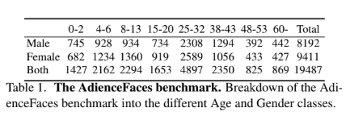
Data set: Adience
Collected from Flikr
Around 26,000 images
2,284 subjects
G. Levi and T. Hassner
Notes:
Mention the strange distribution of age

Slide 4
Image preprocessing
Rescaled to 256x256 pixels
Cropped to 227x227 pixels
1) Center cropping
2) Over-sampling -> yielded higher accuracy

Slide 5
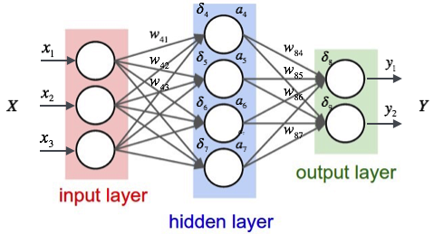
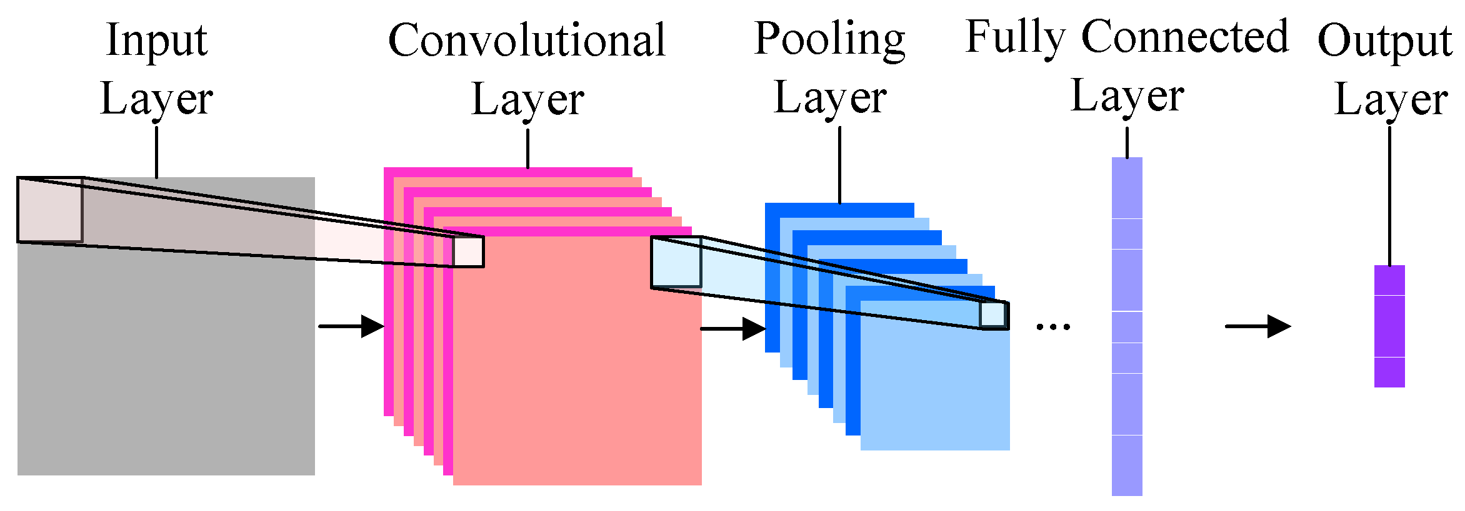
Fully Connected Neural Network
Convolutional Neural Network
https://medium.com/@curiousily/tensorflow-for-hackers-part-iv-neural-network-from-scratch-1a4f504dfa8
http://www.mdpi.com/2078-2489/7/4/61
Notes:
Fully connected: have a large number of parameters, expensive in memory and computation. Mention weights, bias
Conv: specialized, extracts features

Slide 6
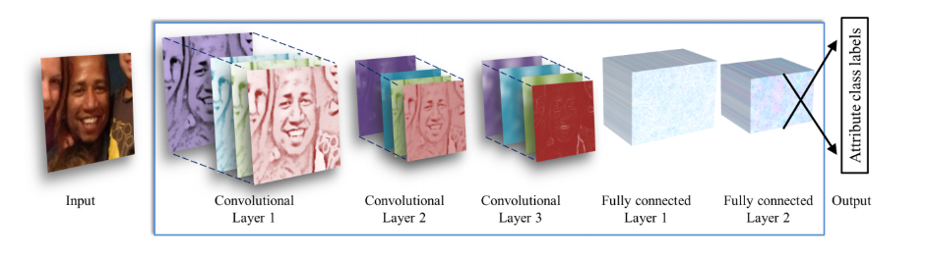
Network Architecture
3 convolutional layers:
1) 96 filters of 3x7x7 pixels
2) 256 filters of 96x5x5 pixels
3) 384 filters of 256x3x3 pixels
2 fully connected layers
——————————————————
5 layers
G. Levi and T. Hassner
Notes:
There’s actually a third fully connected layer that maps to final classes
This is considered a “shallow network”

Slide 7
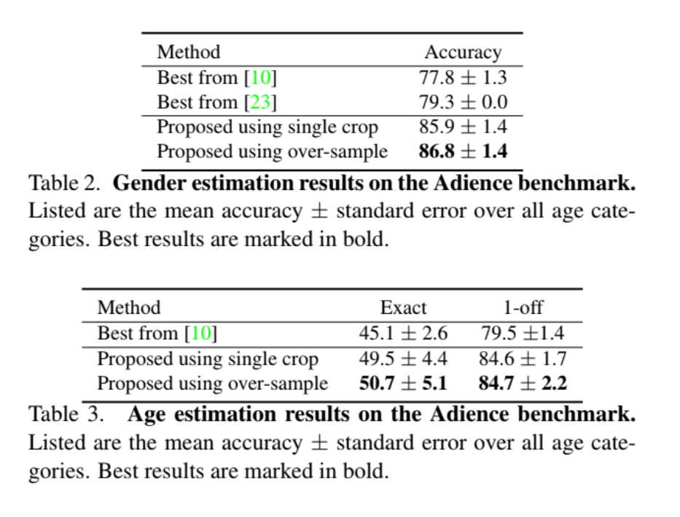
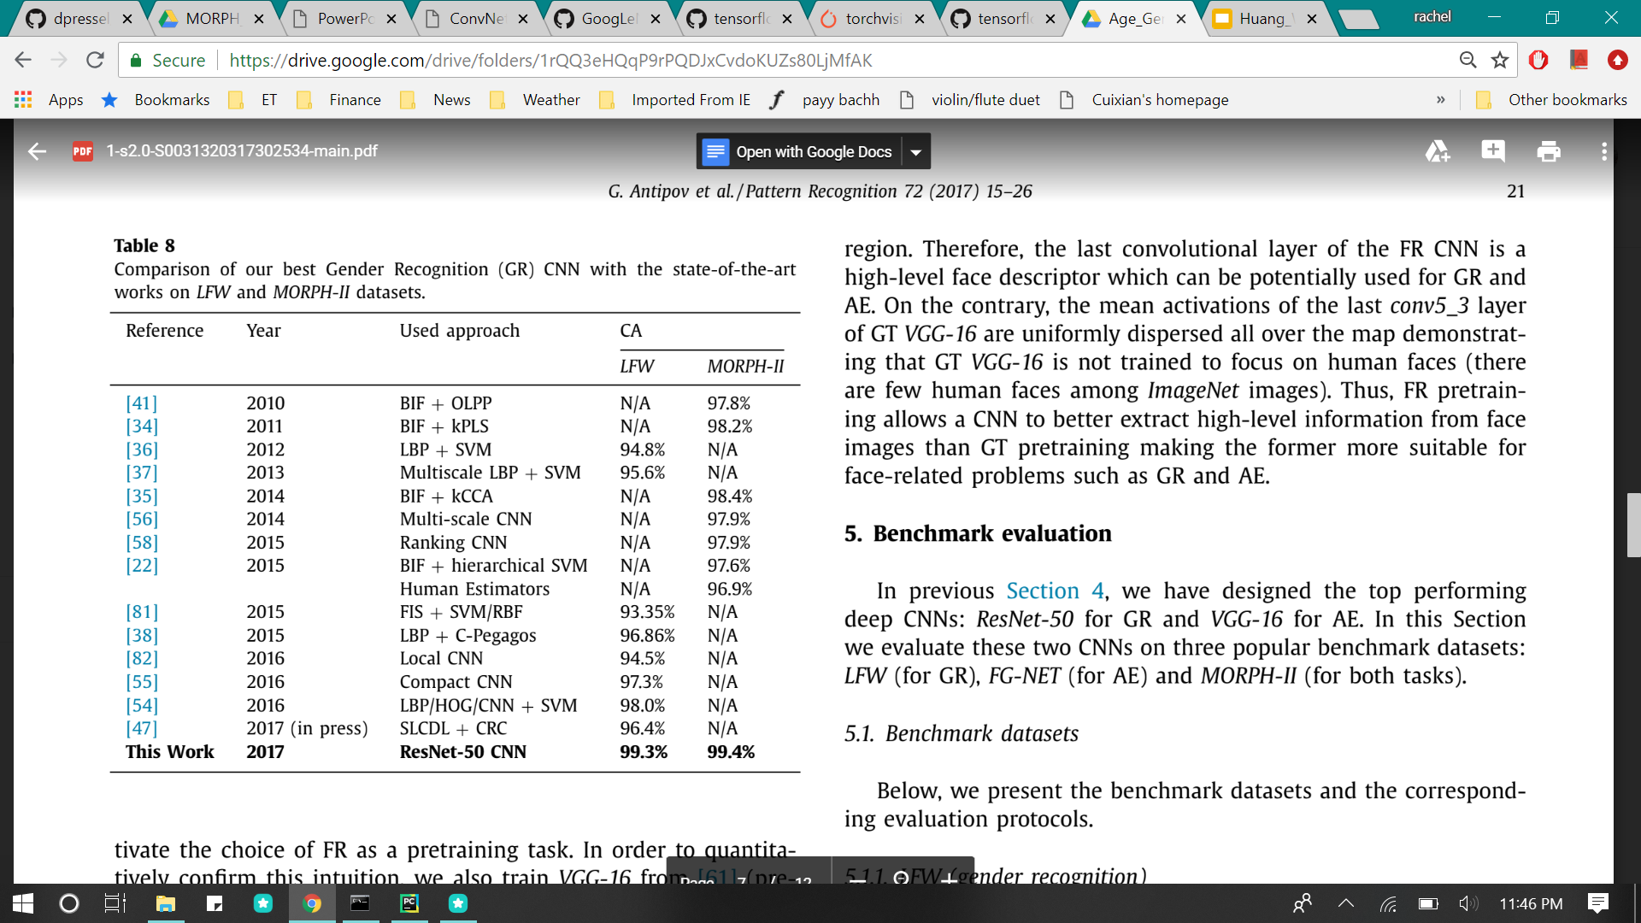
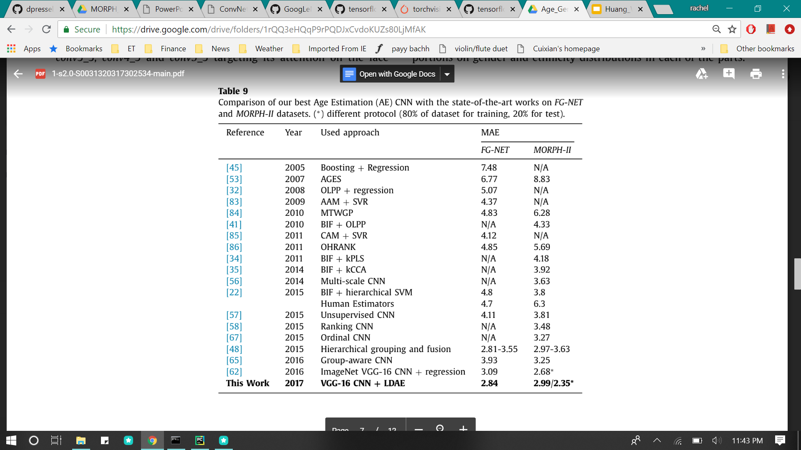
Results (this paper)
Results (2017 paper)
G. Levi and T. Hassner
G. Antipov, M. Baccouche, S.-A. Berrani, and J.-L. Dugelay
Notes:
2017 paper was pretrained on facial recognition, tested on several different neural networks, used a different method of grouping the ages called Label Distribution and Age Encoding (LDAE)

Slide 8



Dr. Chen
88% Female
44% 4-6 years old
27% 15-20 years old
Dr. Wang
97% Male
45% 25-32 years old
33% 38-43 years old
Dr. Wang original
53% Female
62% 25-32 years old
17% 15-20 years old
Notes:
Used GoogleNet implementation in tensorflow

Slide 9
Conclusion
CNN improves performance of age and gender classification
Using a more elaborate system could significantly increase accuracy
Good baseline for future training and testing

Slide 10
Questions?

Slide 11
References
G. Levi and T. Hassner, “Age and gender classification using convolutional neural networks,” 2015 IEEE Conference on Computer Vision and Pattern Recognition Workshops (CVPRW), 2015.
G. Antipov, M. Baccouche, S.-A. Berrani, and J.-L. Dugelay, “Effective training of convolutional neural networks for face-based gender and age prediction,” Pattern Recognition, vol. 72, pp. 15–26, 2017.

